Slide 1

Dynamic OCT methods and its applications
^{Ibrahim Hossein}
Computational Optics Group, University of Tsukuba

Slide 2
Introduction

Slide 3
Measuring the dynamics of cells is an effective marker for the cell health, cell metabolic activities, and pathological transformations.
It is also can be utilized to test tissue and cell drug response.
There are some methods used to explore these dynamics, such as fluorescent correlation spectroscopy (FCS) [1], Phase contrast Microscopy (PCM) [2]. Live cell dynamics imaging have been also performed by super resolution microscopic methods [3].
Due to some limitations of the traditional methods such as invasiveness and limited imaging depth, several groups around the world have been utilized OCT for tissue dynamics imaging
[1] E. L. Elson and D. Magde, Biopolymers 13(1), 1–27 (1974).
[2] N. T. Shaked et. al, , in Coherent Light Microscopy (Springer, 2011), pp. 169–198.
[3] V. Astratov, ed., (Springer International Publishing, 2019).

Slide 4
Dynamic OCT method and applications

Slide 5
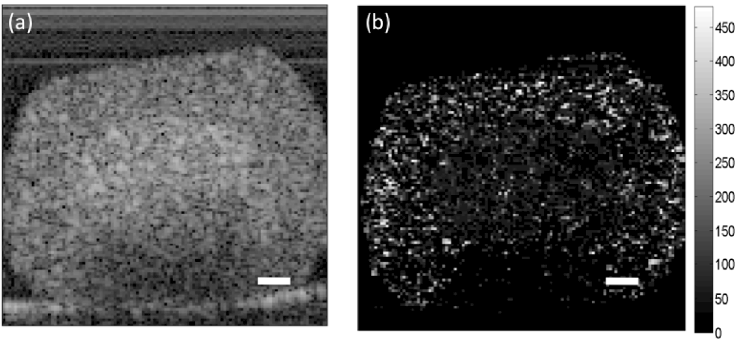
1. Speckle decorrelation dynamics imaging
Farhat [4] have been utilized 1.3 μm swept source OCT with a frame rate acquisition of 50 Hz and axial resolution is 9 μm to measure the tumor spheroid dynamics.
The decorrelation time (DT) was calculated by measuring the half width of the Autocorrelation function at half its maximum value
OCT
DT [ms]
128 axial scans spanning a transverse distance of 1mm
100 μm.
Human colon cancer (HT-29 spheroid)
[4] Farhat, et.al , Proc. SPIE p. 790710 (2011).

Slide 6
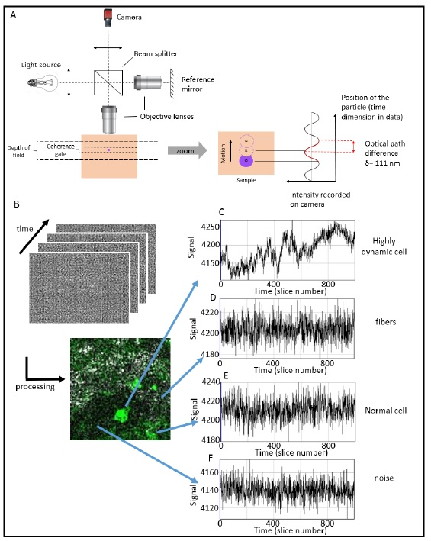

2. Dynamic Full field (DFF-) OCT
It has been performed originally by time Domain full field OCT and standard deviation computation of temporal intensity.
Reprinted from [C. Apelian, et.al, Biomed. Opt. Express 7, 1511–1524 (2016).]

Slide 7
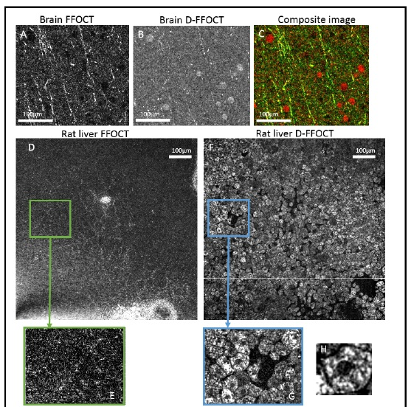
In D-FF-OCT image of mouse brain, the high activity areas are colocalized with some of the dark circular spots on the FFOCT images. Those that remain dark in D-FFOCT may be dead cells or otherwise inactive structures (e.g. capillaries) and thus produce no signal.
Subcellular metabolic activity of large cells such as Hepatocytes of the fresh ex-vivo rat liver is revealed by the D-FF-OCT.
Frame rate of 138 Hz. 1000 frame acquired. Axial resolution is 1 μm
Reprinted from [C. Apelian, et.al, Biomed. Opt. Express 7, 1511–1524 (2016).]

Slide 8
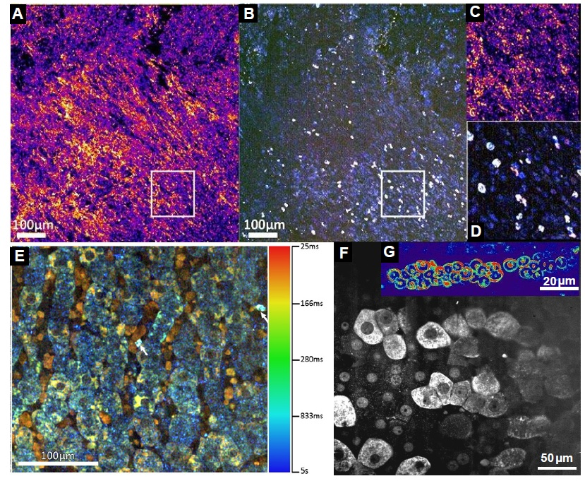
To extract more information about the intracellular dynamics, time frequency analysis have been done for the FF-OCT signal
Time
Fourier transform
Central frequency is set as Hue (H)
Fourier transform
Spectral width is set as Saturation (H)
Fluctuation amplitude (Standard deviation)
Set as Value (V)
HSV DFF-OCT image

Slide 9
FF-OCT
DFF-OCT
(A-D ) ex-vivo subcutaneous pancreatic tumor
(E) DFF-OCT image of a fresh rat liver with 10X 0.3 NA objectives, based on a frequency analysis to compute the color. Cell nucleus can be distinguished as black color and surrounding color from (blue to green) represents the hepatocytes cytoplasm and higher dynamics appearance (yellow) shows the rapidly moving red blood cells trapped inside the capillaries.
DFF-OCT
(F) DFF-OCT image of a similar fresh rat liver with 40X 0.8 NA objectives allowed to measure some dynamics inside the cells nucleus .
(G) High resolution image of red blood cells trapped in a capillary of a fresh rat retina, acquired with
the 40X 0.8 objectives. The better resolution allows to capture the enhanced dynamics localized at the
red blood cells membrane.
Reprinted from [O. Thouvenin, et.al., Appl. Sci. 7, 236 (2017).]

Slide 10
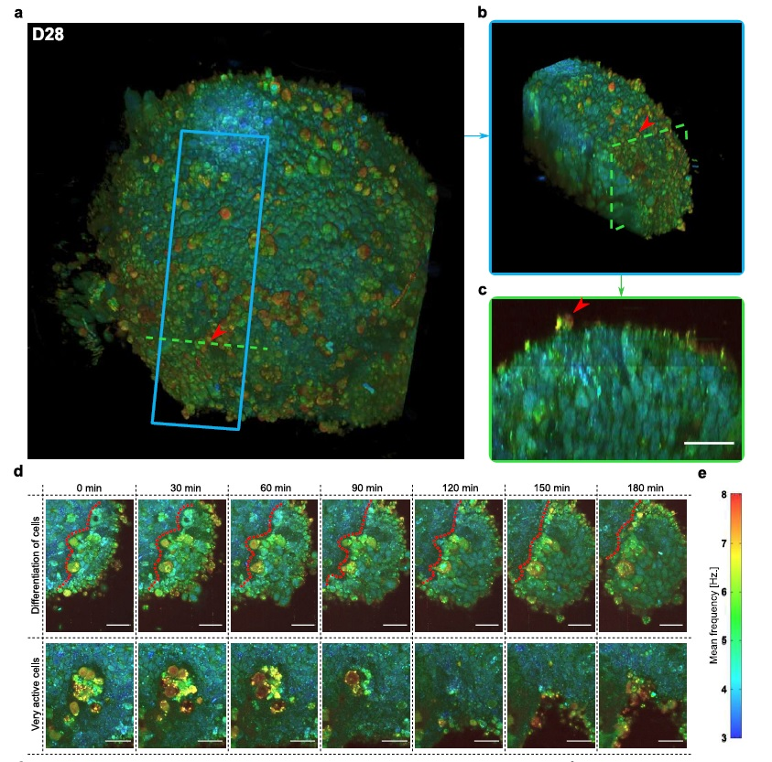
DFF-OCT for retinal organoid imaging
(Human pluripotent stem cell (PSC)-derived 3-D organoids )
Differentiation of retinal progenitors into RPE (the boundary between the two types of cells is represented by a red dotted line),
very active zone, composed of cells exhibiting fast and high dynamics, possibly undergoing
apoptosis, in the center of the organoid.
Frame rate is 100 Hz. 512 frames recorded. And the Axial resolution is 1.7 μm
Reprinted from [J. Scholler, et.al., ” arXiv:1912.04052 [physics] (2019).]

Slide 11
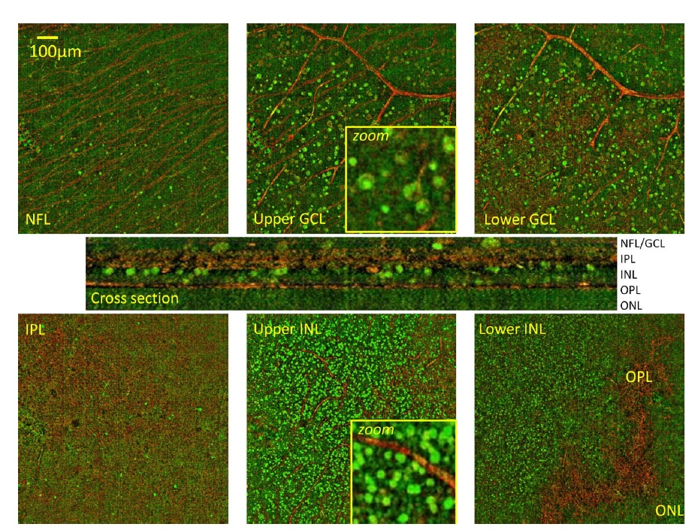
DFF-OCT for retinal layers dynamics imaging
(Dissected macaque retina)
Static (red) and dynamic (green) FFOCT images in macaque retina identify stationary (fibers, vessels, collagen) and dynamic (cell) structures.
Macaque retinal layers. Frame rate is 300 Hz. 1000 frames were recorded.
Reprinted from [O. Thouvenin, et.al.,Investig. Ophthalmol. & Vis. Sci. 58, 4605–4615
(2017).]

Slide 12
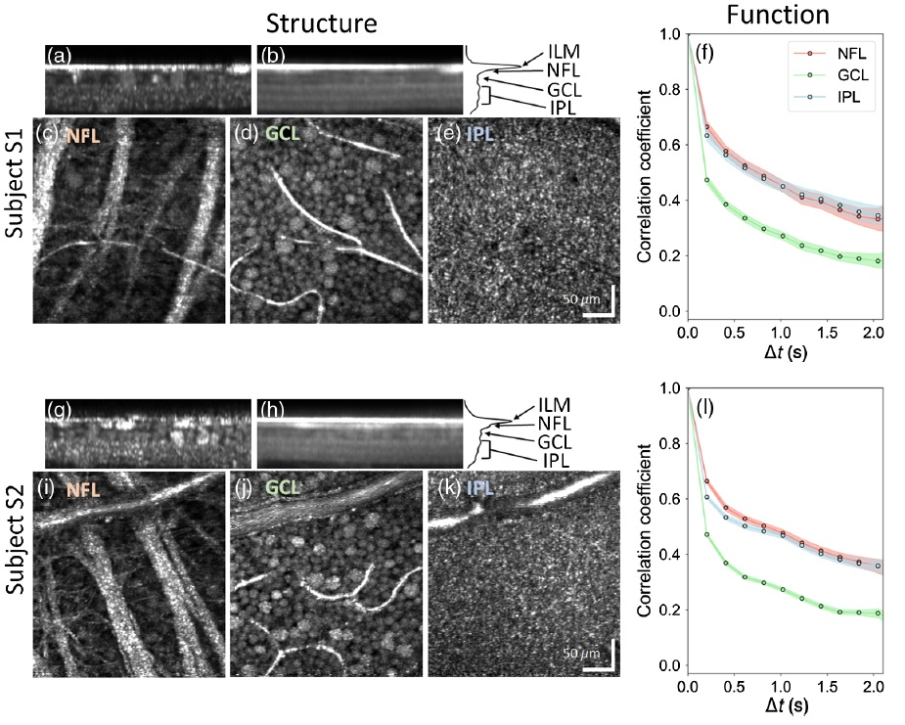
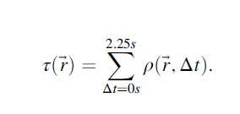
3. Adaptive optics optical coherence tomography (AO-OCT) for retinal layers dynamics imaging
Time constant of correlation
Axial resolution of 4.7 μm in tissue and lateral one is 2.4 μm
Reprinted from [K. Kurokawa, et.al.,” Neurophotonics 7, 015013 (2020). ]

Slide 13
Thank You !

